Slide 1
Topics: Strings – Chapter 13
Today:
String literals
String variables
Next class:
String library functions
Array of strings
Command-line arguments

Slide 2
Introduction
Two types of strings:
String constants (or literals, as they’re called in the C standard)
String variables
Strings are not a type in C .
Strings are arrays of characters in which a special character—the null character—marks the end.
The C library provides a collection of functions for working with strings.

Slide 3
String Constants (Literals)

Slide 4
String Literals
A string literal is a sequence of characters enclosed within double quotes:
"When you come to a fork in the road, take it."
When a string literal is too long:
The backslash character (\) can be used to continue a string literal from one line to the next:
printf("When you come to a fork in the road, take it. \
--Yogi Berra");
When two or more string literals are adjacent, the compiler will join them into a single string.
printf("When you come to a fork in the road, take it. "
"--Yogi Berra");

Slide 5
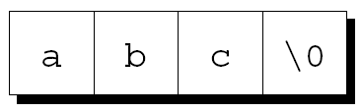
How String Literals Are Stored
When a C compiler encounters a string literal of length n in a program, it sets aside n + 1 bytes of memory for the string.
For example, the string literal "abc" is stored as an array of four characters:
This memory will contain the characters in the string, plus one extra character—the null character—to mark the end of the string.

Slide 6
the null character
The null character is a character with value zero.
a byte whose bits are all zero.
The null character has special significance in C and its derivatives: it servers as a reserved character used to mark the end of strings.
It is represented as the escape sequence '\0'

Slide 7
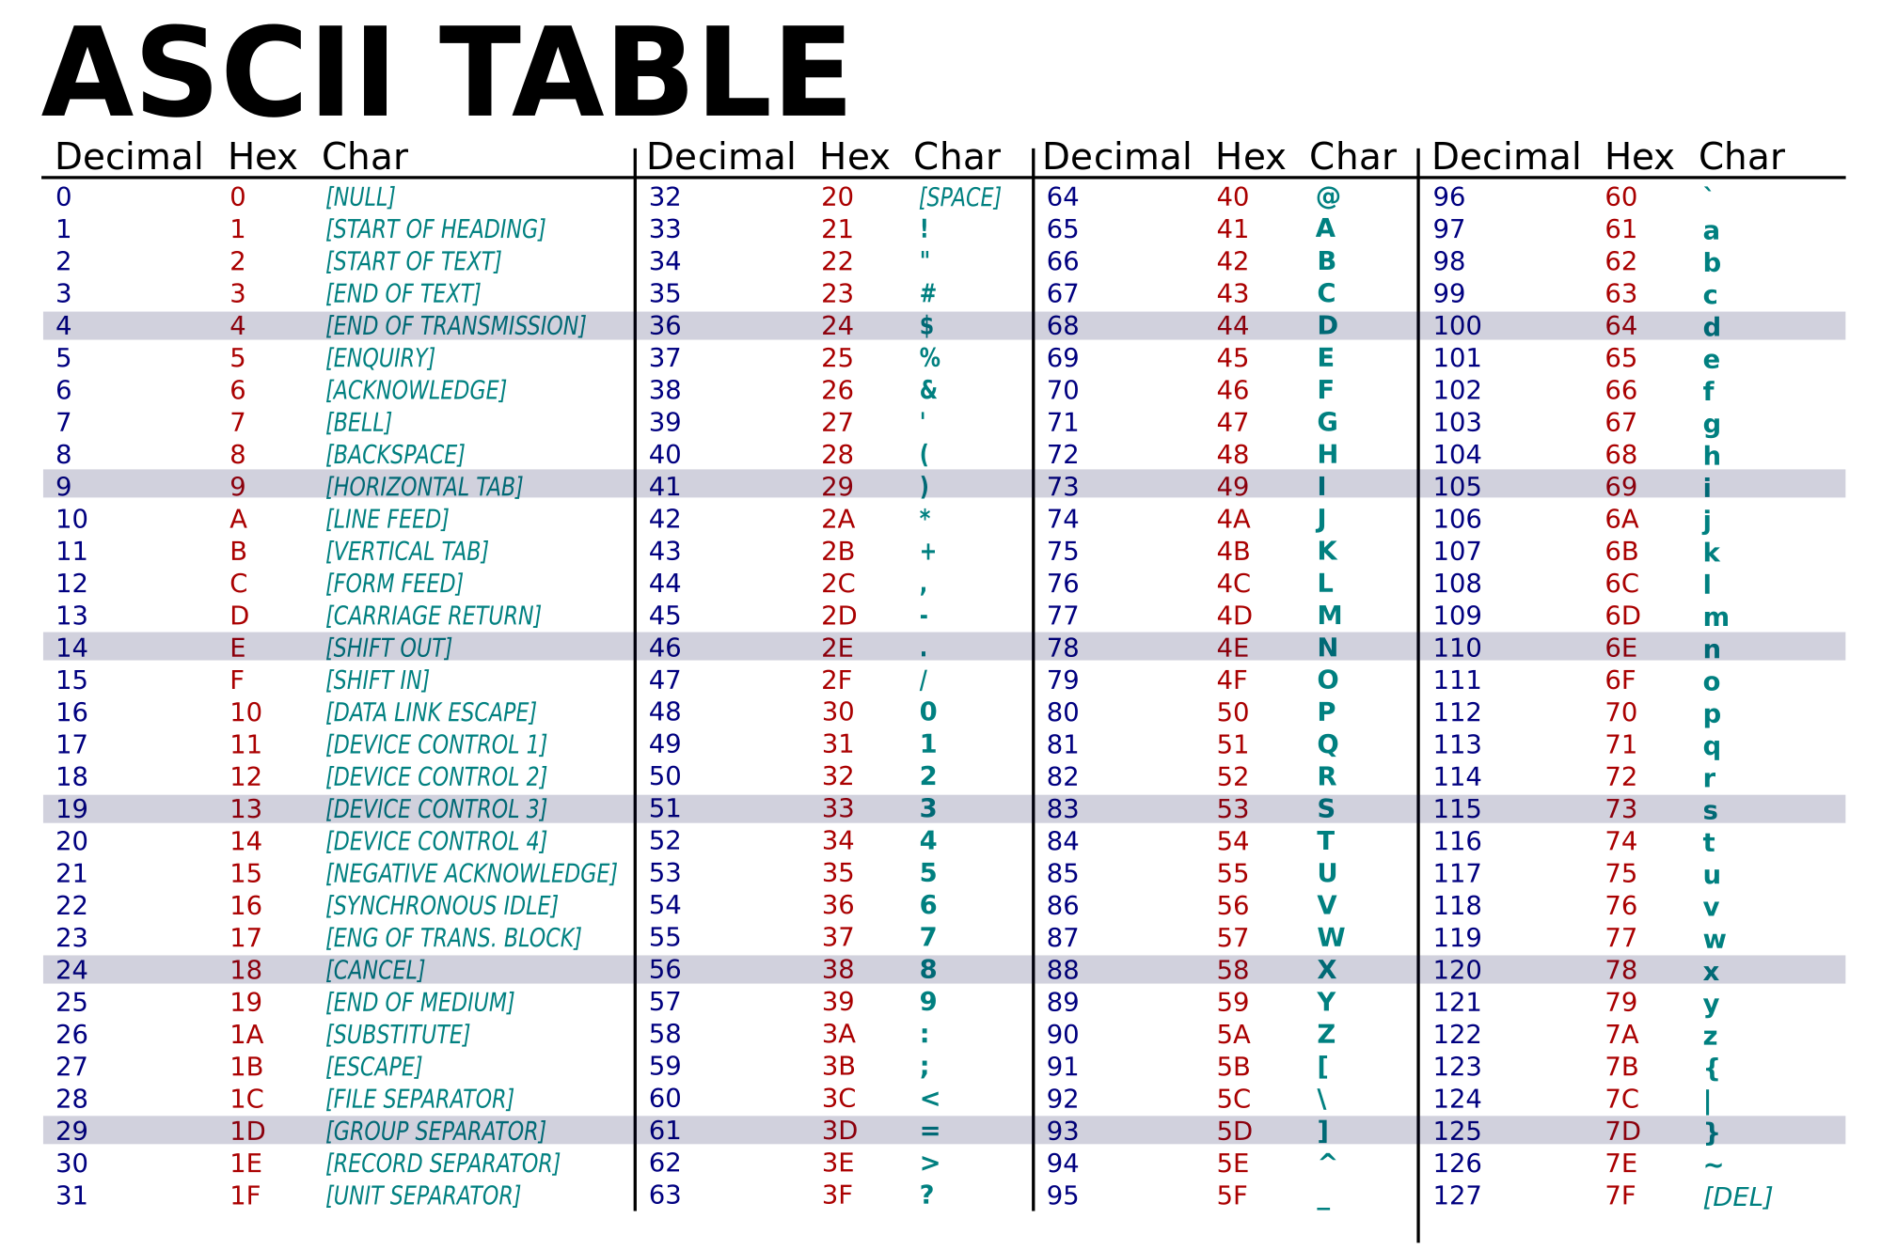

Slide 8

null character/string/pointer
The null character: '\0'
The null string (empty string) "" is stored as a single null character:
The NULL pointer (a macro definition in stdio.h)
A pointer that points to nothing.
int *p = NULL;

Slide 9
How String Literals Are Stored
Since a string literal is stored as an array, the compiler treats it as a pointer of type char *.
We can use a string literal wherever C allows a char * pointer:
char *p;
p = "abc";
This assignment makes p point to the first character of the string.

Slide 10
Operations on String Literals
A string literal (constant) should not be modified.
Attempting to modify a string literal causes undefined behavior:
char *p = "abc";
*p = 'd'; /*** WRONG ***/
A program that tries to change a string literal may crash or behave erratically.

Slide 11
String Variables

Slide 12
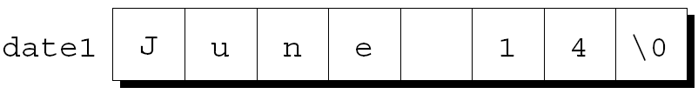
String Variables
Any one-dimensional array of characters can be used to store a string.
A string variable can be initialized at the same time it’s declared:
char date1[8] = "June 14";
The compiler will automatically add a null character so that date1 can be used as a string:
"June 14" is not a string literal in this context.
Instead, C views it as an abbreviation for an array initializer.

Slide 13
String Variables
If a string variable needs to hold 80 characters, it must be declared to have length 81:
#define STR_LEN 80
…
char str[STR_LEN+1];
Adding 1 to the desired length allows room for the null character at the end of the string.
Defining a macro that represents 80 and then adding 1 separately is a common practice.

Slide 14
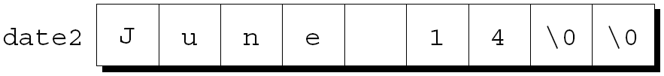
Initializing a String Variable
If the initializer is too short to fill the string variable, the compiler adds extra null characters:
char date2[9] = "June 14";

Slide 15
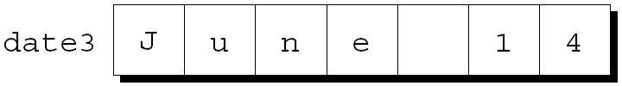
Initializing a String Variable
An initializer for a string variable can’t be longer than the variable, but it can be the same length (bad practice)
char date3[7] = "June 14";
There’s no room for the null character
Failing to leave room for the null character may cause unpredictable results when the program is executed.

Slide 16
Initializing a String Variable
The declaration of a string variable may omit its length, in which case the compiler computes it:
char date4[] = "June 14";
The compiler sets aside eight characters for date4, enough to store the characters in "June 14" plus a null character.
Omitting the length of a string variable is especially useful if the initializer is long, since computing the length by hand is error-prone.

Slide 17
Character Arrays versus Character Pointers
The declaration
char date[] = "June 14";
declares date to be an array,
The similar-looking
char *date = "June 14";
declares date to be a pointer.
In the array version, the characters stored in date can be modified. In the pointer version, date points to a string literal that shouldn’t be modified.

Slide 18
Exercise
Which of the following statements is NOT legal?
char ch[] = "cd";
char *ch = "ab";
char ch = 89;
char *ch = 'x';

Slide 19
Accessing the Characters in a String

Slide 20
Accessing the Characters in a String
Since strings are stored as arrays, we can use subscripting to access the characters in a string.
A function that determines if there is a space in a string:
int find_space(char s[])
{
int i;
for (i = 0; s[i] != '\0'; i++)
if (s[i] == ' ')
return 1;
return 0;
}
20

Slide 21
Accessing the Characters in a String
A version that uses pointer arithmetic instead of array subscripting :
int find_space(char *s)
{
char *p;
for (p = s; *p != '\0'; p++)
if (*p == ' ')
return 1;
return 0;
}
21

Slide 22
Exercise
The function definition below determines the number of characters of a string. Which one of the following is correct in place of the missing statement?
int count_character(char *s){
char *p;
int count = 0;
//missing statement
return count;
}
for (p = s; p != '\0'; p++) count++;
for (p = s; p != "\0"; p++) count++;
for (p = s; *p != '\0'; p++) count++;
for (p = s; *p != "\0"; p++) count++;

Slide 23
Example Program
Write a program that concatenates a string to another string.

Slide 24
Reading and Writing Strings

Slide 25
Writing Strings Using printf and puts
The %s conversion specification allows printf to write a string:
char str[] = "Are we having fun yet?";
printf("%s\n", str);
The output will be
Are we having fun yet?
printf writes the characters in a string one by one until it encounters a null character.

Slide 26
Reading Strings Using scanf
The %s conversion specification allows scanf to read a string into a character array:
char str[20];
scanf("%s", str);
str is treated as a pointer, so there’s no need to put the & operator in front of str.

Slide 27
Reading Strings Using scanf
When scanf is called, it skips white space, then reads characters and stores them in str until it encounters a white-space character.
scanf always stores a null character at the end of the string.

Slide 28
scanf
As they read characters into an array, scanf has no way to detect when it’s full.
Consequently, it may store characters past the end of the array, causing undefined behavior.
scanf can be made safer by using the conversion specification %ns instead of %s.
n is an integer indicating the maximum number of characters to be stored.
scanf("%20s", str);

Slide 29
Reading Strings Using scanf
Consider the following program fragment:
char sentence[SENT_LEN+1];
//SENT_LEN is 20
printf("Enter a sentence:\n");
scanf("%s", sentence);
Suppose that after the prompt
Enter a sentence:
the user enters the line
To C, or not to C: that is the question.
scanf will store the string "To" in sentence.
A white space before T
29

Slide 30
Reading Strings
scanf won’t usually read a full line of input.
A new-line character will cause scanf to stop reading, but so will a space or tab character.
To read an entire line of input, we have the following options:
gets function: unsafe, no way to detect when the array is full
Write our own input functions

Slide 31
Write our own input functions: Reading Strings Character by Character
Programmers often write their own input functions.
Suppose we need a function that (1) doesn’t skip white-space characters, (2) stops reading at the first new-line character (which isn’t stored in the string), and (3) discards extra characters if the input line contains more than n characters.
A prototype for the function:
int read_line(char str[], int n);
read_line will return the number of characters it stores in str.

Slide 32
Reading Strings Character by Character
read_line consists primarily of a loop that calls getchar to read a character and then stores the character in str, provided that there’s room left:
int read_line(char str[], int n)
{
int ch, i = 0;
while ((ch = getchar()) != '\n')
if (i < n)
str[i++] = ch;
str[i] = '\0'; /* terminates string */
return i; /* number of characters stored */
}
ch has int type rather than char type because getchar returns an int value.

Slide 33
read_line, pointer version
int read_line(char *str, int n)
{
int ch, i = 0;
while ((ch = getchar()) != '\n')
{ if (i < n)
{ *str++= ch;
i++;
}
}
*str = '\0'; /* terminates string */
return i; /* number of characters stored */
}

Slide 34
Programming Exercise
Modify the read_line (the pointer version) function:
Have it skip the white spaces before beginning to store input characters
Test your program with input:
Are we having fun yet?
The output should be:
Are we having fun yet?
//without the white spaces before the beginning character

Slide 35
main
#define STR_LEN 10
int main()
{
int num_chars;
char sen[STR_LEN+1];
printf(“Enter a sentence: ");
num_chars = read_line(sen, STR_LEN);
printf(“You entered: %s, it has %d characters", sen, num_chars);
return 0;
}

